Slide 1

Health problems and concerns common to adolescents
By: Amanda Jiruska

Slide 2
Topics to be covered
Acne
Eating disorders
Depression
Changes related to puberty

Slide 3
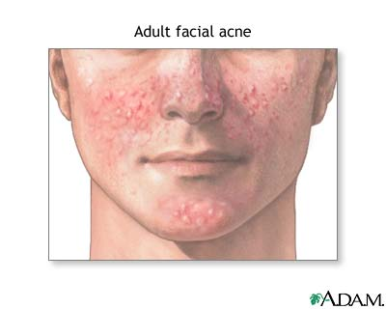
Acne
Acne is the most common skin problem in the United States.
40 to 50 million Americans have acne.
Acne can effect the face, upper neck, shoulders, chest, and back.
89% of teenagers suffer from acne.
Some reasons why acne develops: genetics, inflammation of the skin, stress, and medication use.

Slide 4
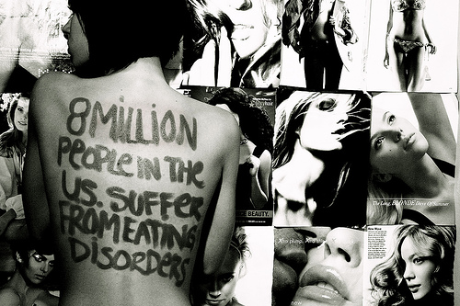
Eating disorders
The two most common types: anorexia nervosa and bulimia nervosa.
Anorexia nervosa:
  Individual starves themselves because of a distorted body image and a fear of gaining weight.
  The cause is unknown
  The media has a negative impact on young growing bodies.
  90% affected are females.
  Suffer describes themselves as “fat”.
  Compulsive exercising.
  Self induced vomiting

Slide 5
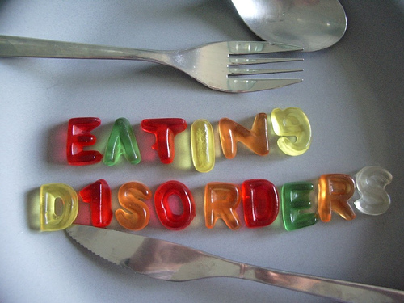
Eating disorders
Bulimia nervosa:
  Behavior characterized by eating binges followed by feelings of guilt, humiliation, and low self worth.
  Self induced vomiting.
  Exact cause is unknown
  Affects 9 females for every 1 male.
  Bulimia has been found to begin in adolescents.
  Strongly associated with depression.
  The person can be thin or overweight.

Slide 6

Depression
Signs of depression include:
  Feeling sad
  Feeling tired all the time
  Sleep to little or to much
  Cry a lot
  No interest in eating
  Eating too much
  Having trouble paying attention
  Feeling nervous or cranky
  Thinking about death or suicide
  Things that used to make you happy don’t anymore
Everyone feels sad at times. People with depression feel sad most days. These feelings can get in the way of your everyday life.
Depression can be treated with medicine or counseling.

Slide 7
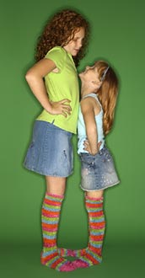
Changes related to puberty
Puberty is when changes occur that turn the child body into the adult body.
During puberty, major differences of size, shape, composition, and function develop in many body structures and systems.
Girls begin puberty at 10 and boys begin at 12 years old.
Some characteristics of puberty:
  Body and facial hair
  Voice changes
  Body shape
  Body odor
  acne

Slide 8
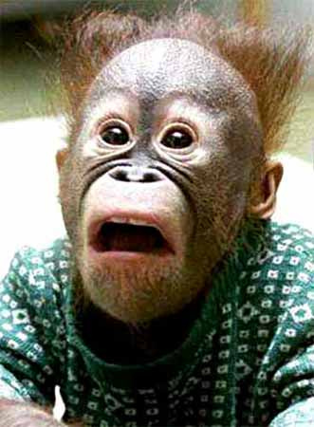
The end

